Slide 1
Some discrete Probability Distribution
Chapter 5

Slide 2
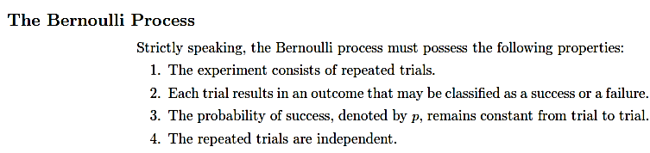

Slide 3
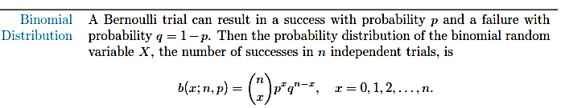

Slide 4
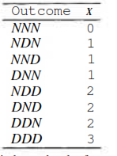

3 items are selected at random. With replacement. 25 % are defective. What is the probability 1 item is defective.

Slide 5
27/128

Slide 6


Slide 7


Slide 8
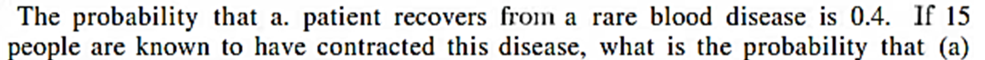

Slide 9


Slide 10
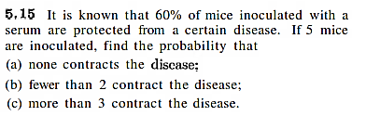

Slide 11
Ex: 5.2, Ex: 5.4 – 5.15

Slide 12
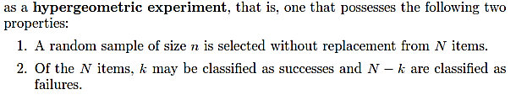
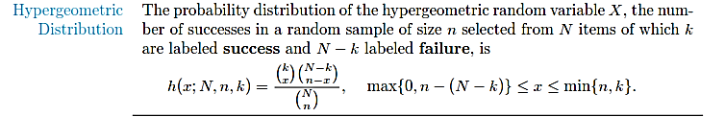
Hypergeometric Distribution

Slide 13


Slide 14


Slide 16


Slide 17


Slide 18
Ex 5.29 – 5.35

Slide 19
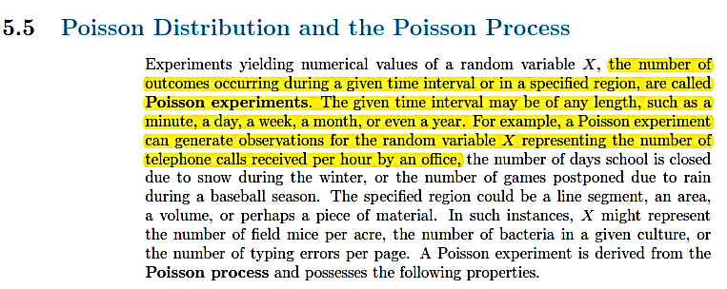
Poisson Distribution

Slide 20
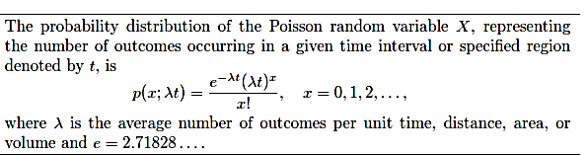
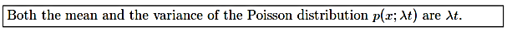

Slide 21
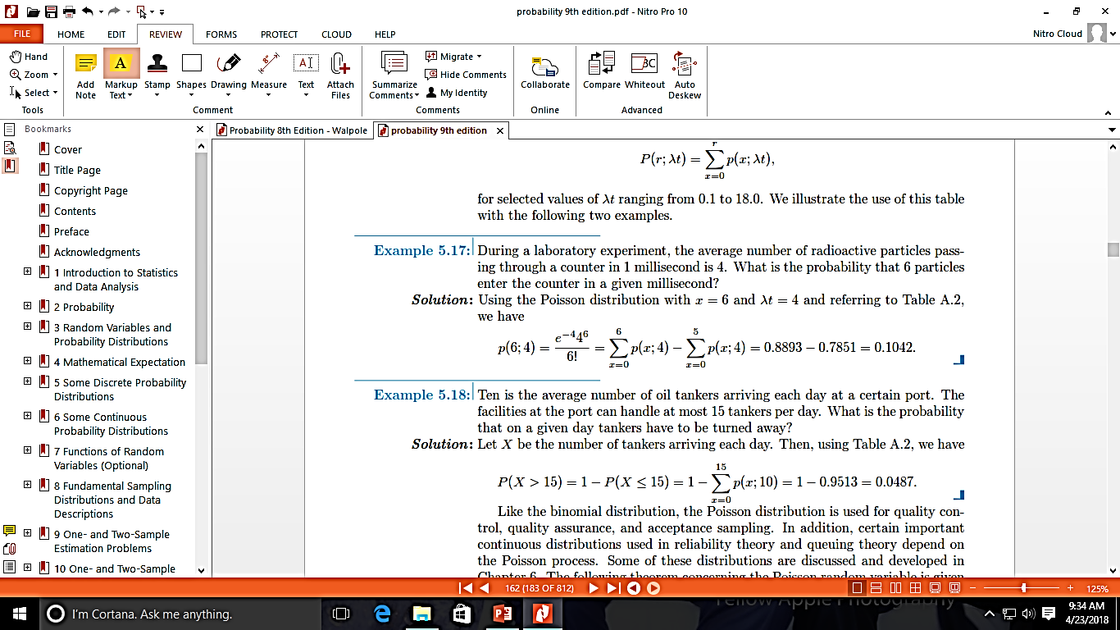

Slide 23
